Slide 1
L02 - Software Life Span M odels
Stages that software goes through, from conception to death
Stages may be very different
Software = product
  stages are similar to the stages in the life span of other products
© 2012 Václav Rajlich, with additions from D. Hou Software Engineering: The Current Practice Ch. 2

Slide 2
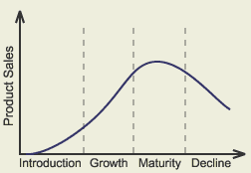
Product lifespan

Slide 3
Software lifespan
Software is a product
  sales go through the same lifespan
Names of stages are different

Slide 4
Staged model
Initial development
first version
evolution changes
Evolution
evolution stops
servicing patches
Servicing or Maintenance
servicing discontinued
Phase-out
switch-off
Close-down

Slide 5
Initial development
Requirements
Design
Implementation
  similar to waterfall
Fundamental decisions
  technology
    programming language, coding conventions, libraries,…
  architecture
    components, interactions
  program domain knowledge
    the knowledge is required for evolution

Slide 6
Evolution
Adapts the application to the ever-changing user and operating environment
  Adds new features
  Fixes bugs; Corrects mistakes and misunderstandings
Responds to both developer and user learning
Responds to changes in technology
Both knowledge of software architecture and of team are necessary for successful evolution
Program usually grows during evolution

Slide 7
Evolution stops
Managerial decision
  business reasons to stop evolution
Software stabilization
  problem is solved
  no reason to continue evolution
Code decay

Slide 8
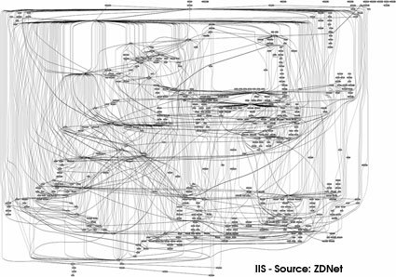
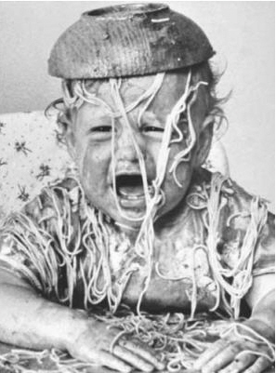
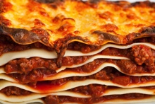
Code decay
Loss of software coherence
Loss of the software knowledge
  less coherent software requires more extensive knowledge
  if the knowledge is lost, the changes will lead to a faster deterioration
Loss of key personnel = loss of knowledge
Challenge: eliminate or slow down code decay

Slide 9
Servicing = Maintenance
No additions of new functionality
Changes are limited to patches and wrappers
  less costly, but they cause further deterioration
Process is very different from evolution
  no need for senior engineers
  the process is predictable
    well suited to process measurement and management

Slide 10
Reversal from servicing to evolution
Expensive, rare
Not simply a technical problem
  the knowledge of the software team must also be recovered

Slide 11
Reengineering
Initial development
first running version
software changes
Evolution
reengineering
code decay
servicing patches
Servicing
servicing discontinued
Phase-out
switch-off
Close-down

Slide 12
Phase-out
No more servicing is being undertaken
  but the system still may be in production
Users must work around known deficiencies

Slide 13
Close-down
Software use is disconnected
  current life of successful software:
  about 10 to 20 years
Users are directed towards a replacement
An ‘exit strategy’ is needed.
  changing to another system requires retraining
  what to do with long-lived data?

Slide 14
Versioned staged model
Used by software with many users
Evolution is the backbone of the process
  evolution produces versions
  versions are serviced, phased-out, closed down

Slide 15
Versioned staged model
Initial development
first running version
evolution changes
Evolution Version 1
servicing patches
Servicing Version 1
evolution of new version
evolution changes
Phase-out Version 1
Evolution Version 2
servicing patches
Close-down Version 1
Servicing Version 2
evolution of new version
Phase-out Version 2
Evolution Version . . .
Close-down Version 2
Notes:
Other products that go through similar lifespan models?
PC/laptop
Cars?

Slide 16
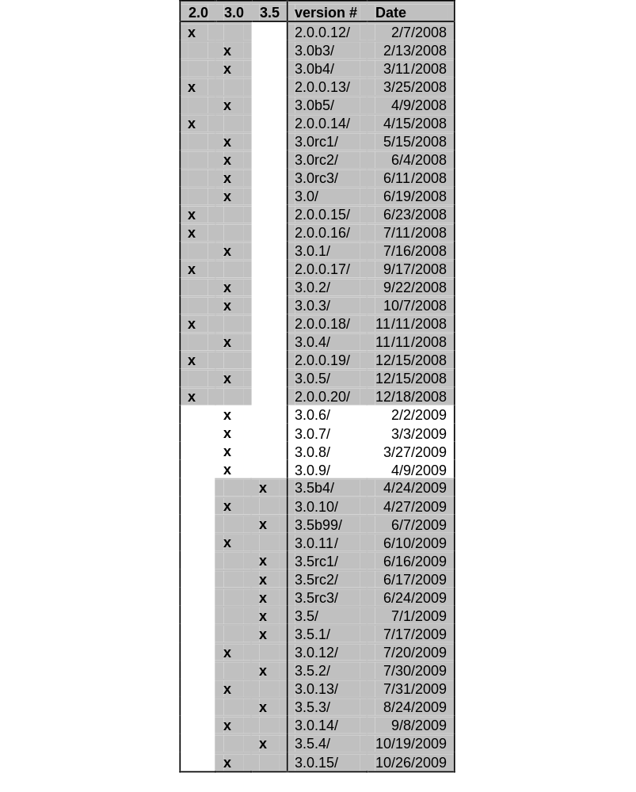
Mozilla Firefox releases
2008 – 2009
Versions 2.0 and 3.0
  serviced in parallel
Version 3.5 introduced 4/2009
  while version 3.0 still serviced
  while version 2.0 in
  phase-out
Notes:
Other products that go through similar lifespan models?
PC/laptop
Cars?

Slide 17
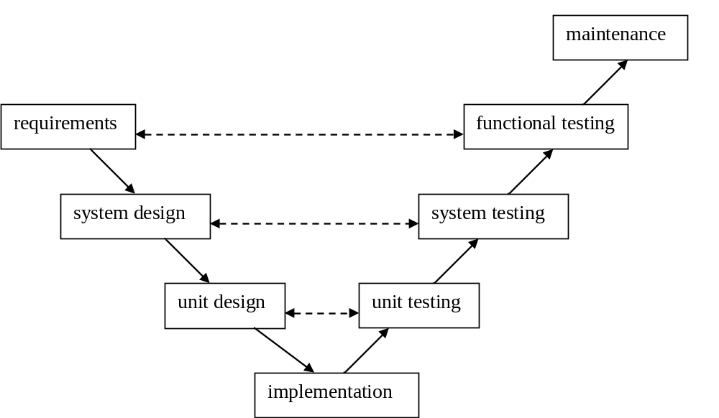
V-Model

Slide 18
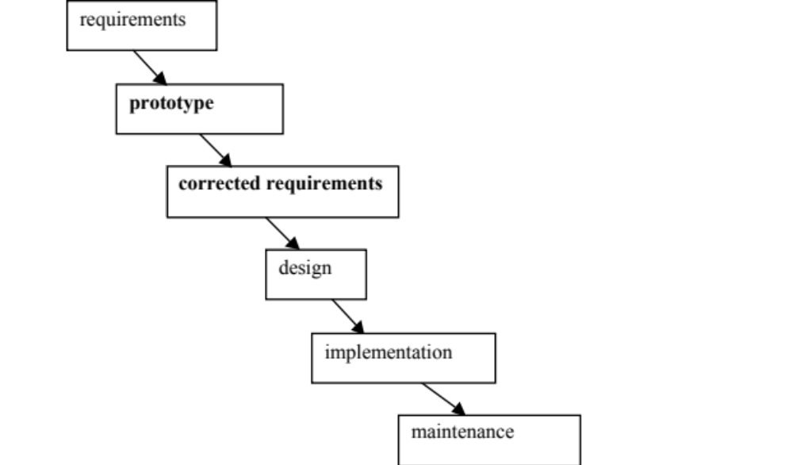
Prototyping model

Slide 19
Incomplete lifespans
Discontinued projects
  stopped during initial development
Stable domain
  no need for evolution
Development starts with evolution
  a related old software is evolved into new one

Slide 20
Lifecycle vs. lifespan model
Lifecycle
  common terminology
  incorrect: There is no cycle
    some software discontinued without a replacement
Lifespan model
  better terminology
  less commonly used

